Slide 1
Surgical Glasses
Team 26

Slide 2


Slide 3


Problem?
Also,
Time Wastage & Improper Communication the biggest factors leading to loss of lives of thousands of people every year.
The problem of Patient Safety in Surgeries has not been fully addressed.
Journal, BioMedicalCentral published in 2014 clearly highlights the following reasons in impacting doctor’s sense of judgement and decision taking:
Breakdown in communication within and amongst the surgical team.
Delay in diagnosis.
Delay in treatment.
.
(data by WHO, 14 September 2019)
2.6 Million Deaths

Slide 4
Improper communication between doctor and staff can cost a patient his life!

Slide 5
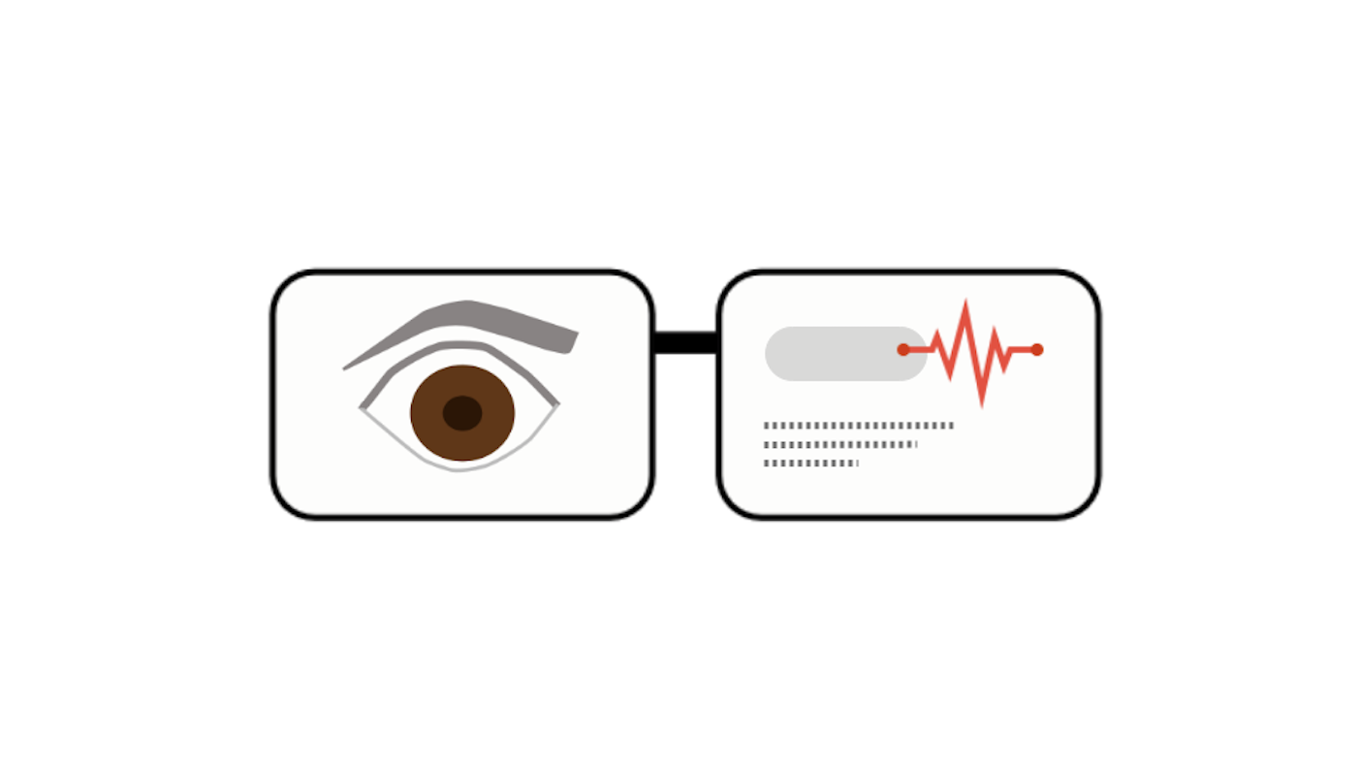
Introducing,
Smart Surgical Glasses

Slide 6
Smart Surgical Glasses
Features Smart Surgical Glasses displays:
Important vitals of the patient(eg: Oxygen level, Heart rate, BP etc).
Displays important information as summarized text of key words.
Eye tracking.
Displays memo before operation to the doctor.
Target Audience
Surgeons
Operating Staff

Slide 7
Summarized Text as Keyword
Akshat give the patient Anesthesia Isoflurane
Doctor: Anesthesia Isoflurane

Slide 8
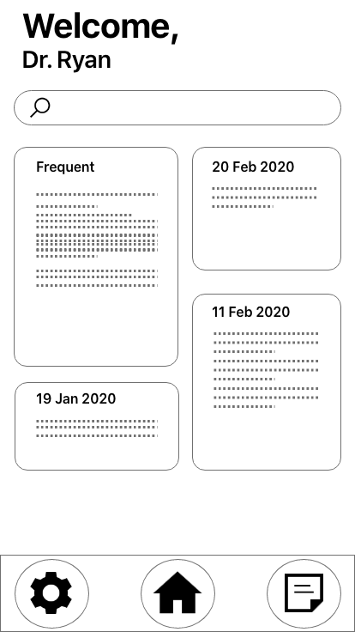
App UI
(Provided as an additional service to the surgeons)
Quick Search Records
Records/ Details of Operations
Settings
Home
Quick Note

Slide 9
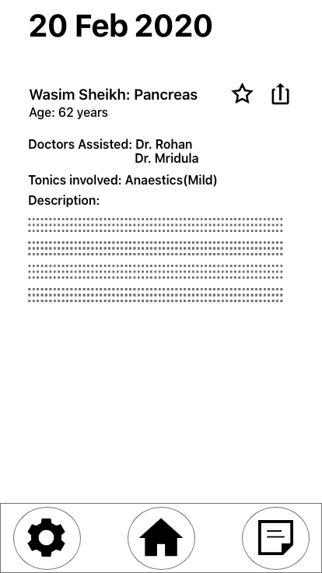
In-app Patient Records
Displaying a short description of records to the surgeons which include:
Details of Patient (eg. His/her area of operation, age, recent vitals)
Doctors assisted during surgery
Tonics which were involved in surgery
General Description

Slide 10
Tech Stack
The Future
Web Development (HTML, CSS, Bootstrap, JQuery, JS, Python [Django]).
IoT and Physics.
Adafruit libraries.
Computer Vision.
Microsoft Azure.
Flutter.
Heroku
$220 billion industry in the Indian market by 2020 due to immediate need in surgeries.
We intend to scale it and add more related features with the help of industry professionals.

Slide 11
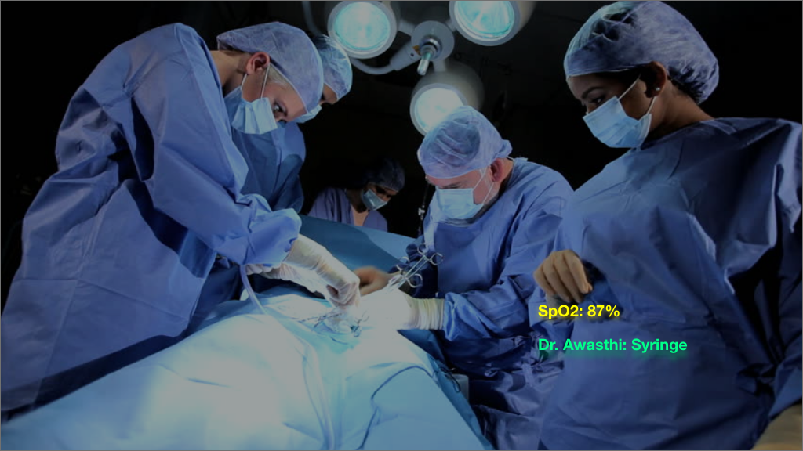

Slide 12
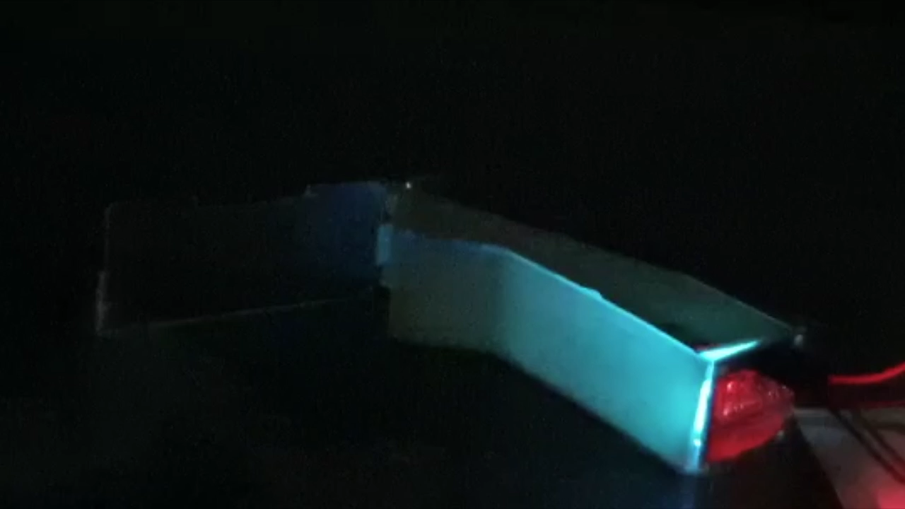

Slide 13
Thank You
-Team 26

